Slide 1
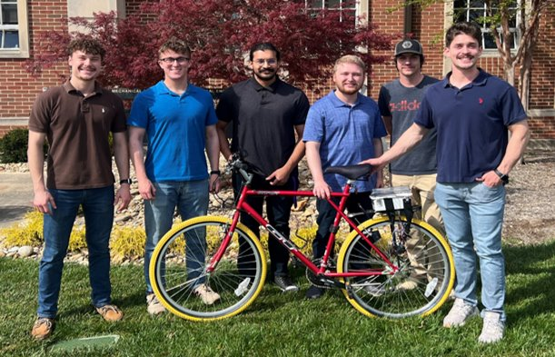
The Ride Replay Kit
Team Members: Jesse Brewster, Ben Ebel, Jayden Marcom, Caleb Rozenboom, Caleb Turney, Utsav Singha
Faculty Advisor: Mr. Jesse Roberts

Slide 2
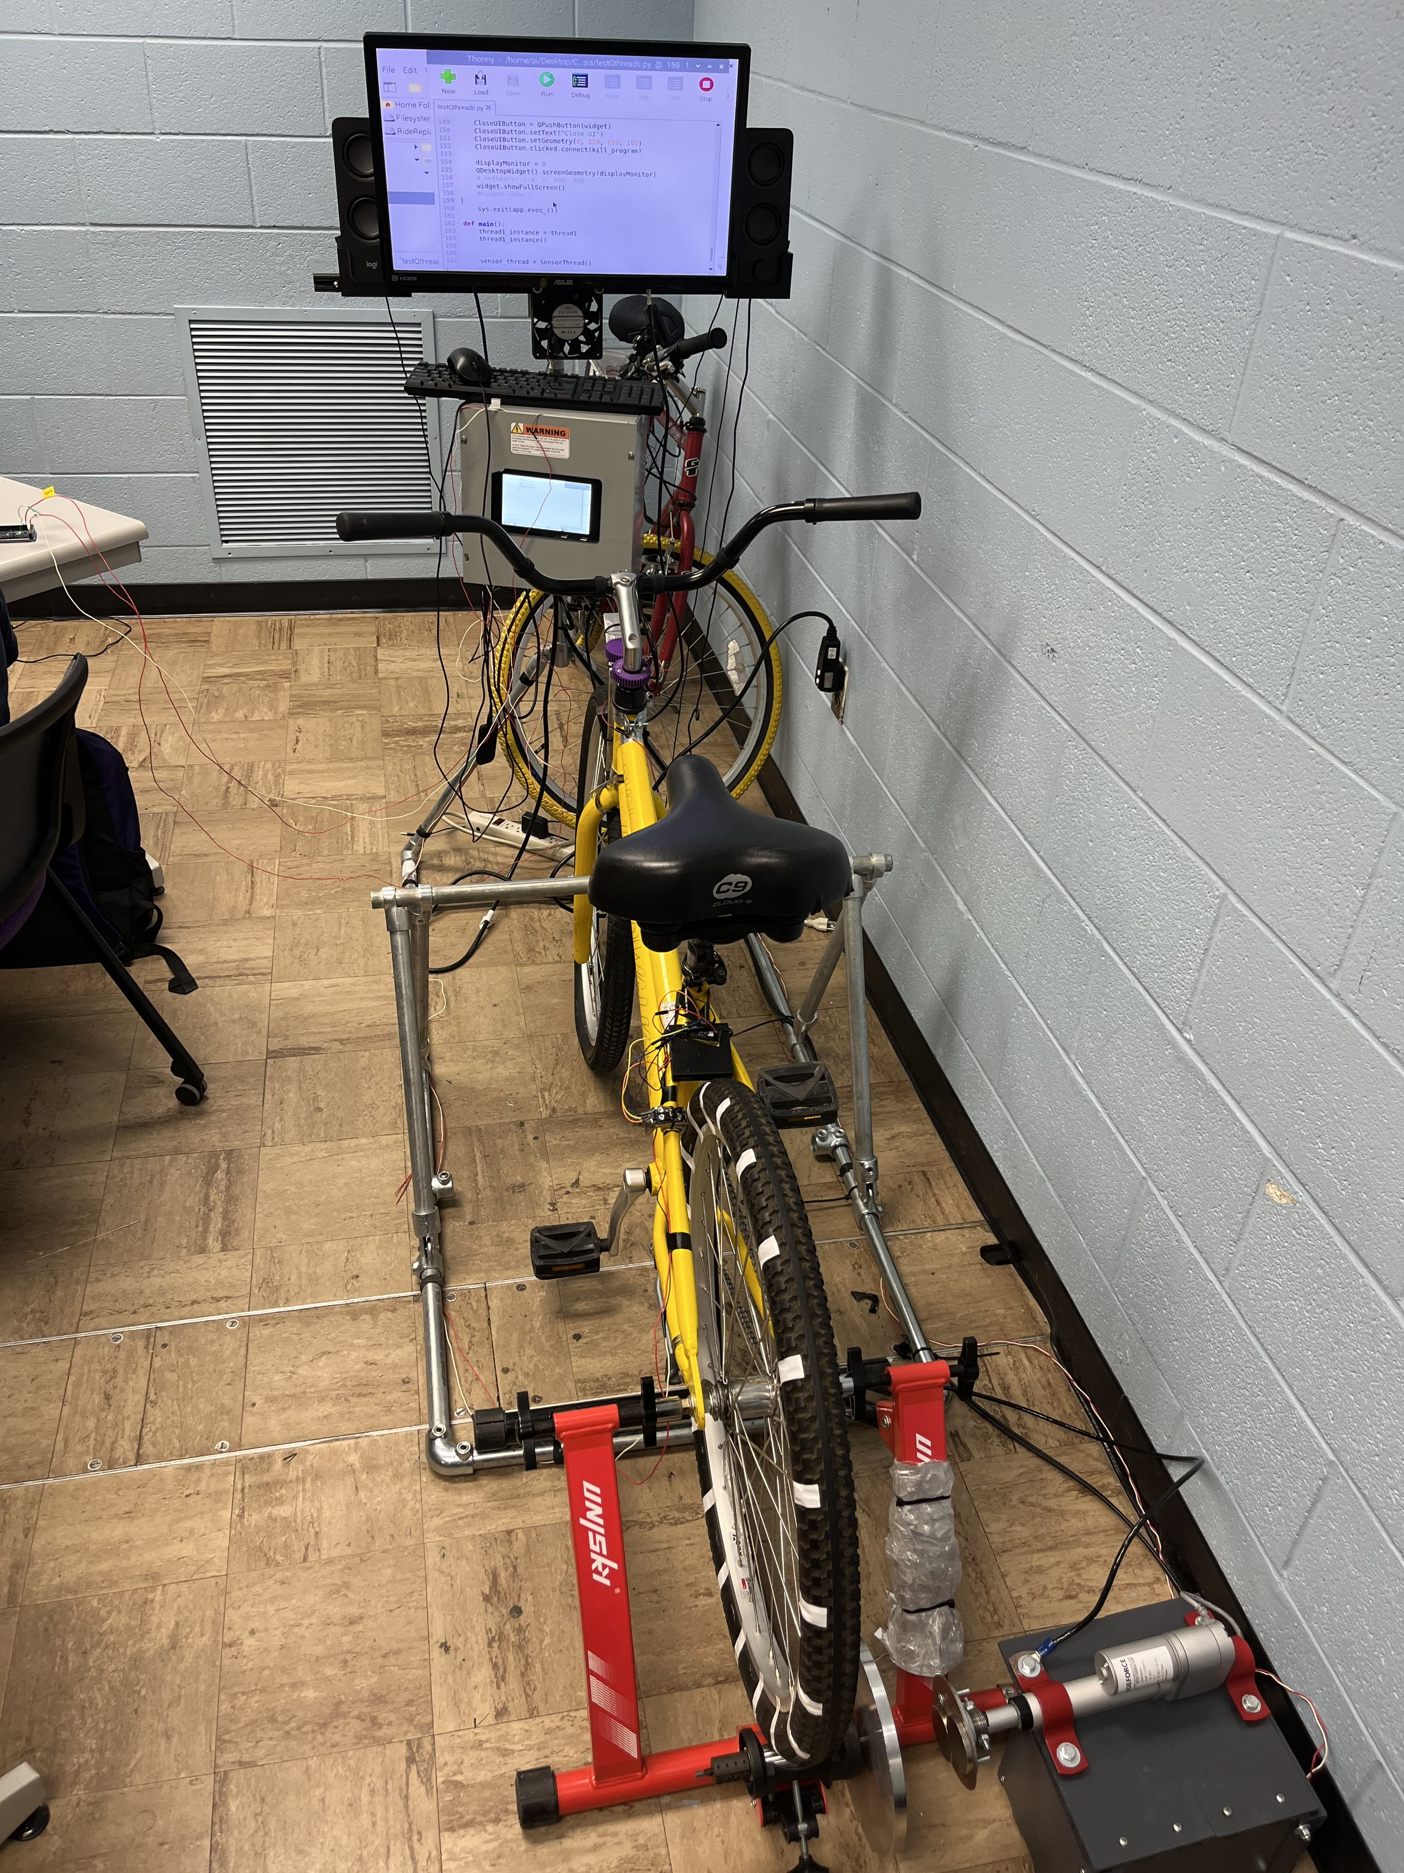
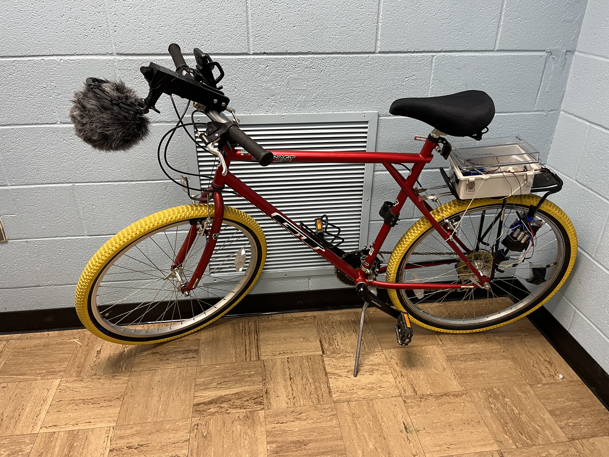
Introduction
Notes:
Introduce the problem
problem
Objectives
Record trail data
Create Work Map
Calculate Resistance
Iterate through Work Map
Allow user interaction and control
Audio playback
Visual playback
Wind recreation

Slide 3
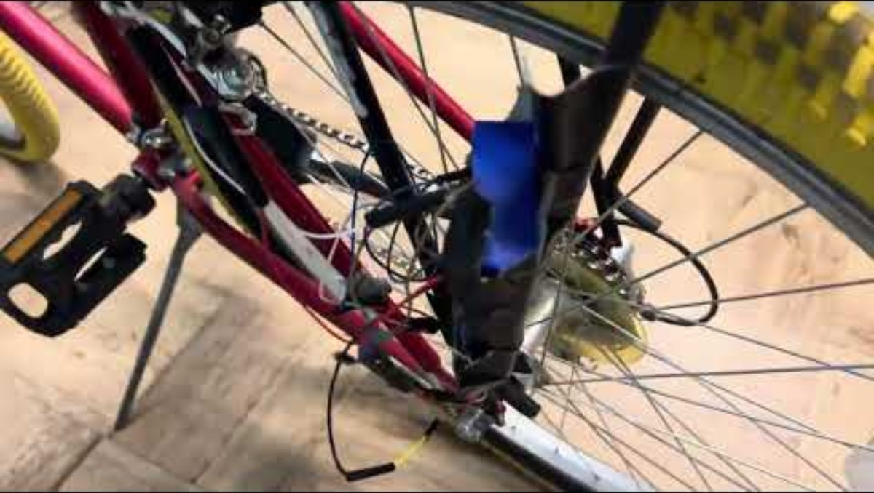

Slide 4
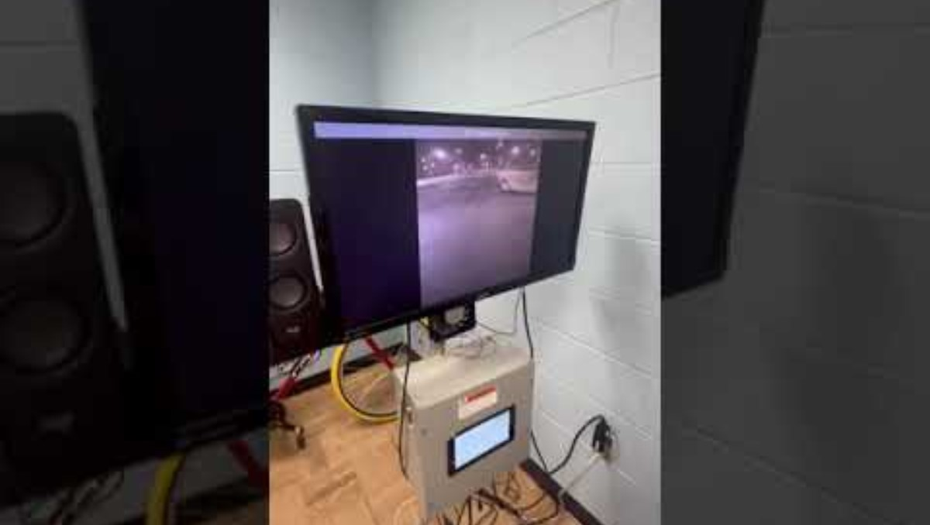

Slide 5
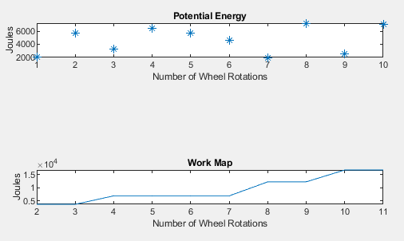
Notes:
The potential Energy graph is here to help visualize
The potential energy graph is essentially the trail being ridden
The work map is the potential energy graph summed together without the down hills

Slide 6

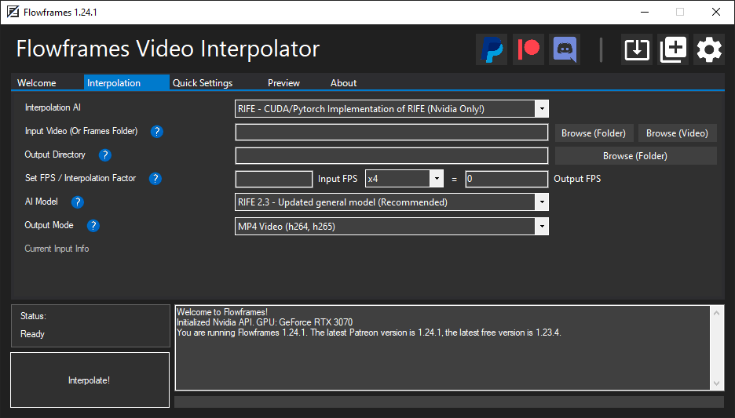
Video Subsystem
Video Playback
Goal: To sync video playback with work done throughout trail progression.
Replay video scales with the user’s pedal speed
Video is interpolated video up to 240FPS to ensure smooth video replay
Notes:
Camera – iPhone 14 recording at 60FPS
Frame rate – 240FPS
Resolution – 480p
Interpolation – FlowFrames to interpolate videos recorded at 60FPS up to 240FPS

Slide 7
Video Subsystem Analysis
Results:
Video is capable to be up to 2 hours in length.
Video must be replayed at 480p.
Each individual frame does play back on the monitor.
Notes:
After testing, to confirm the constraints set earlier were valid, we found that:
each frame does play back ensuring smoothness even at smooth speeds

Slide 8

Audio Subsystem
Audio Playback
Goal: to sync audio with the work done throughout trail progression while reducing any extraneous noises.
Process audio on another computer to divide the audio into sections.
Python code plays back audio sections in accordance to the progression of the trail.
Loop different sections of audio.
Notes:
Microphone – Cardioid Polar Pattern 180 degrees
Decibel Limit – 80 dB at 1 meter
Speakers – Had to specify maximum audio output
Syncing/Looping Audio – Python code with work divisions and playback
Microphone used: Blue Snowball
Speakers Used: Logitech Z207
To solve the problem of pitching and stretching audio files, Team 5 decided to loop different sections of audio until the user has progressed past that section.
The Python code gets uploaded to the cloud and then is processed on another computer to divide the audio files.
In order to sync the audio with the user biking, the python accepts work values and plays back different audio sections in accordance to the progression of the trail.

Slide 9
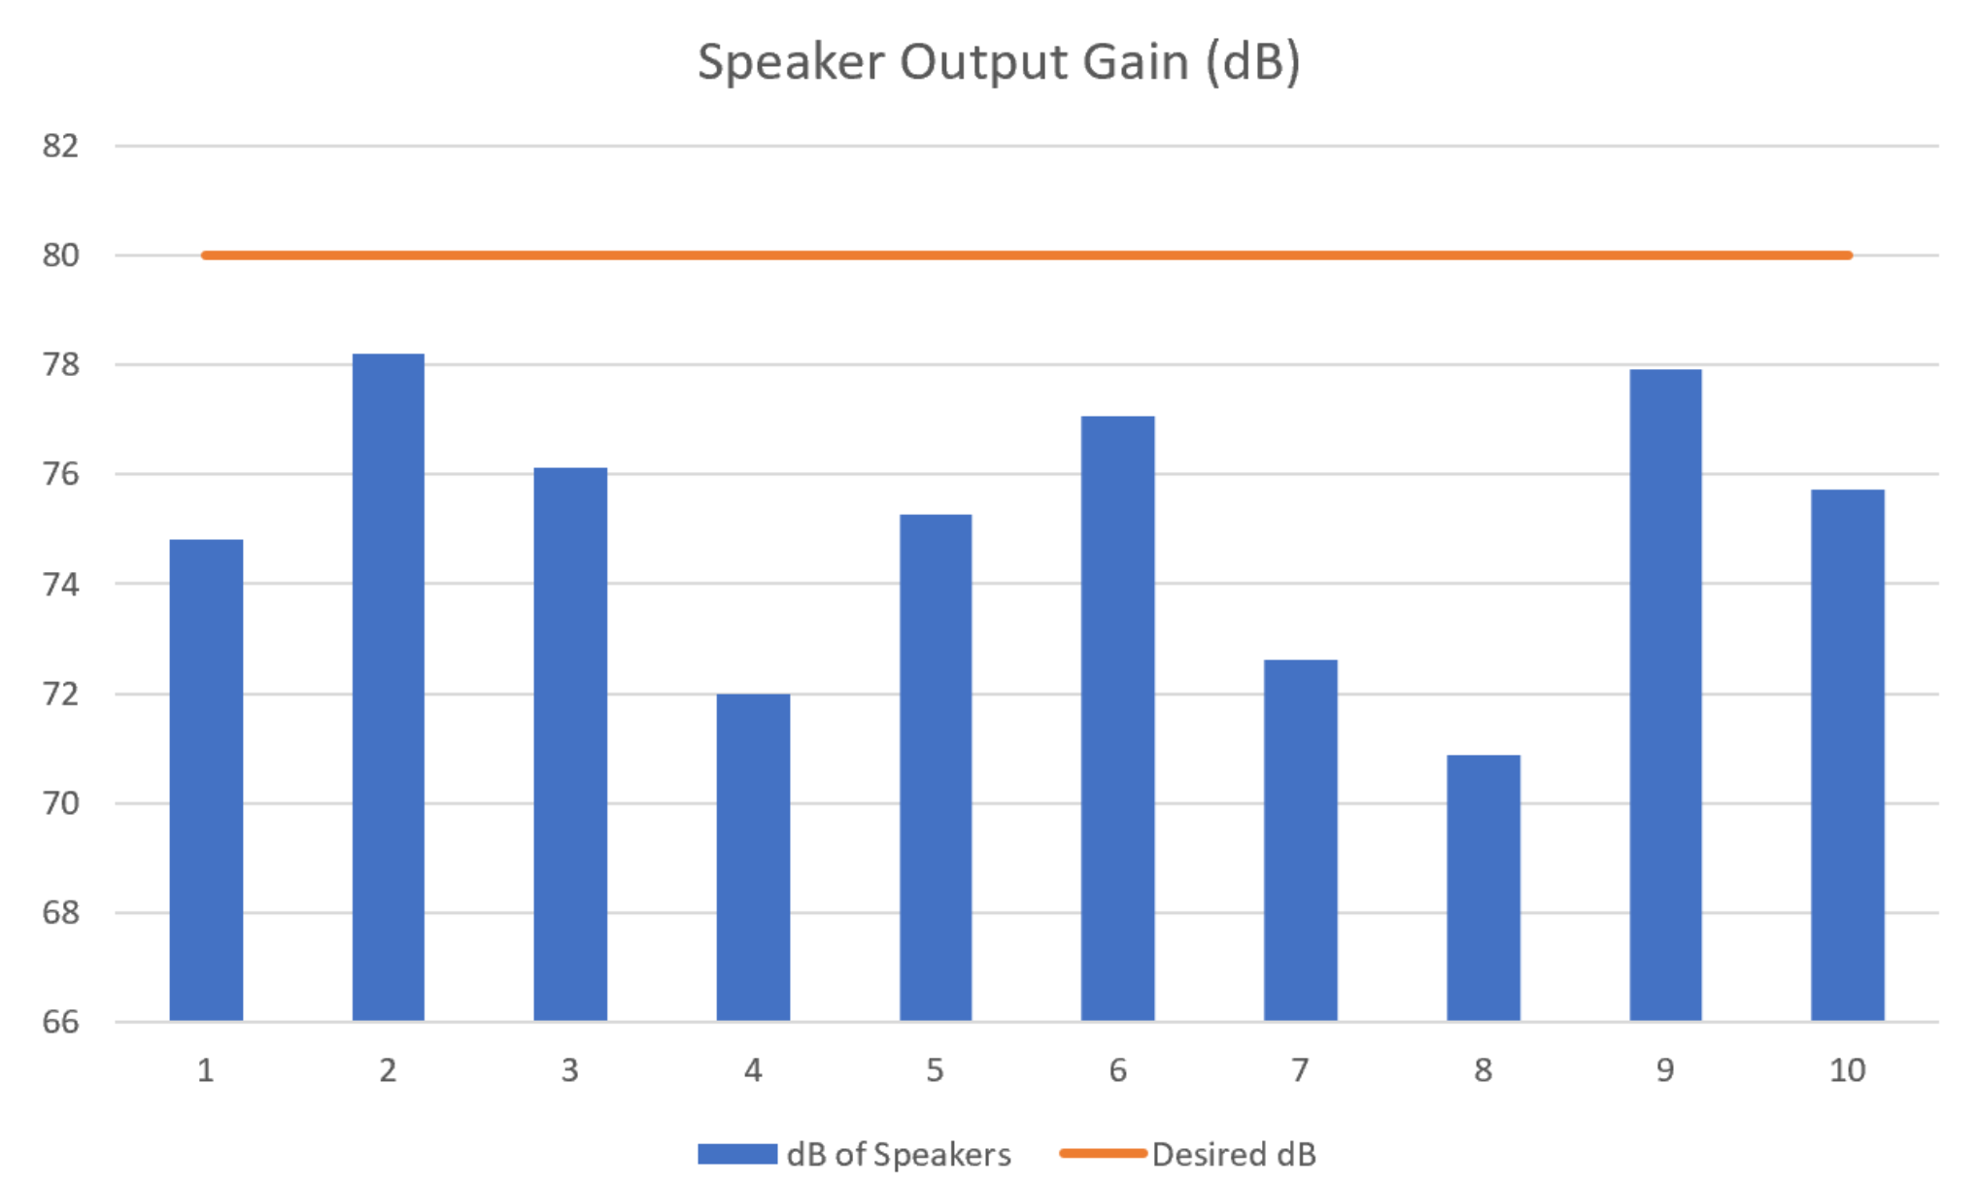
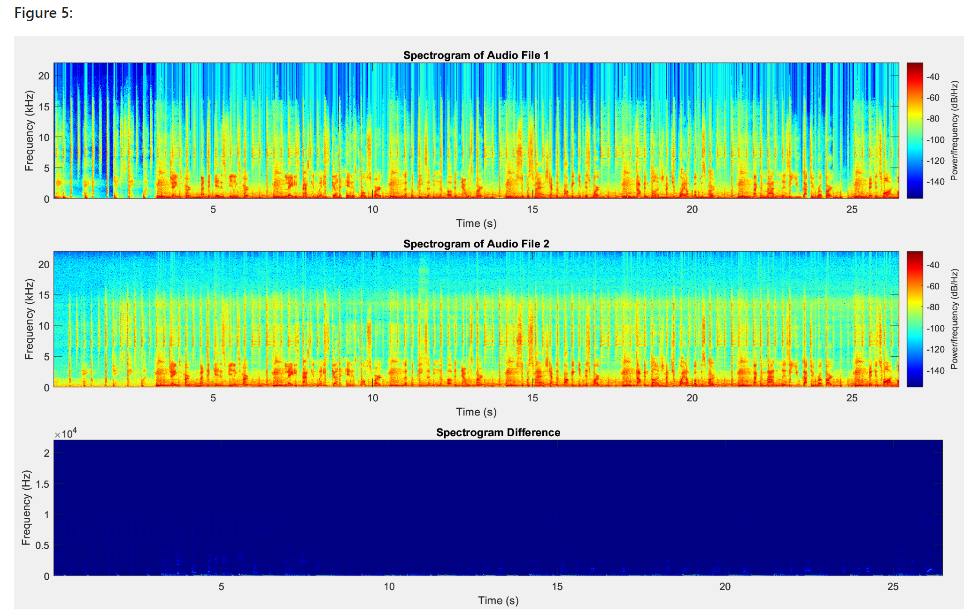
Audio Subsystem Analysis
Results: Audio files were played back in sync with the work values with little frequency and audio quality loss.
Audio output was tested to be less than 80 dB output from the speakers.
Notes:
Work values spanned 610 to 5700 Joules.
These work values were divided and corresponded to the different sectionalized 30 second audio files.
Ableton Live was used to filter out any frequencies that may be unwanted in the recording 80 Hz and 7 kHz.
Root Mean Square was 0.254 dB so very little difference in audio quality.
Speakers were turned all the way up and multiple audio files from the trail were put through the Raspberry Pi and the max volume we got was around 78.2 dB
Mention AI audio software that can remove voices and reduce bike sounds.

Slide 10
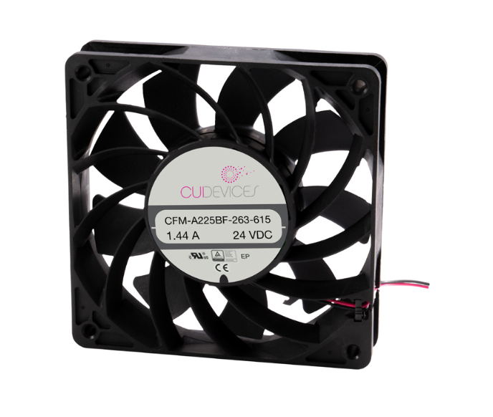
Immersion Subsystem
Components
12V DC Brushless Fan
12V 5A 60W DC Power Supply
Arduino ATMega 2560

Slide 11
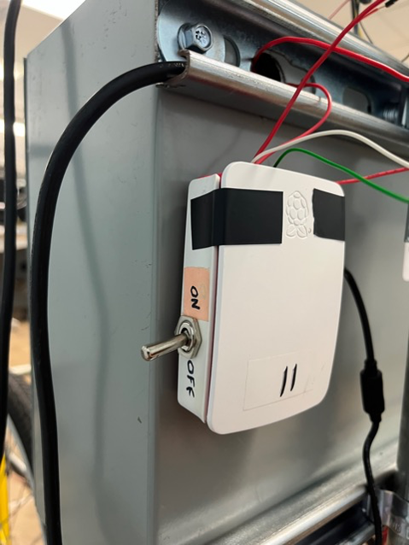
Immersion Subsystem Considerations
Have a Cubic Feet Per Minute (CFM) sufficient to reach the user
Be PWM controllable so that the speed can be manipulated and controlled by input from bike.
Have an off button implemented into the GUI to disable functionality.
Mapped to bike speed to give an accurate feeling of wind speed.
Have an output noise level under 65 dB.

Slide 12
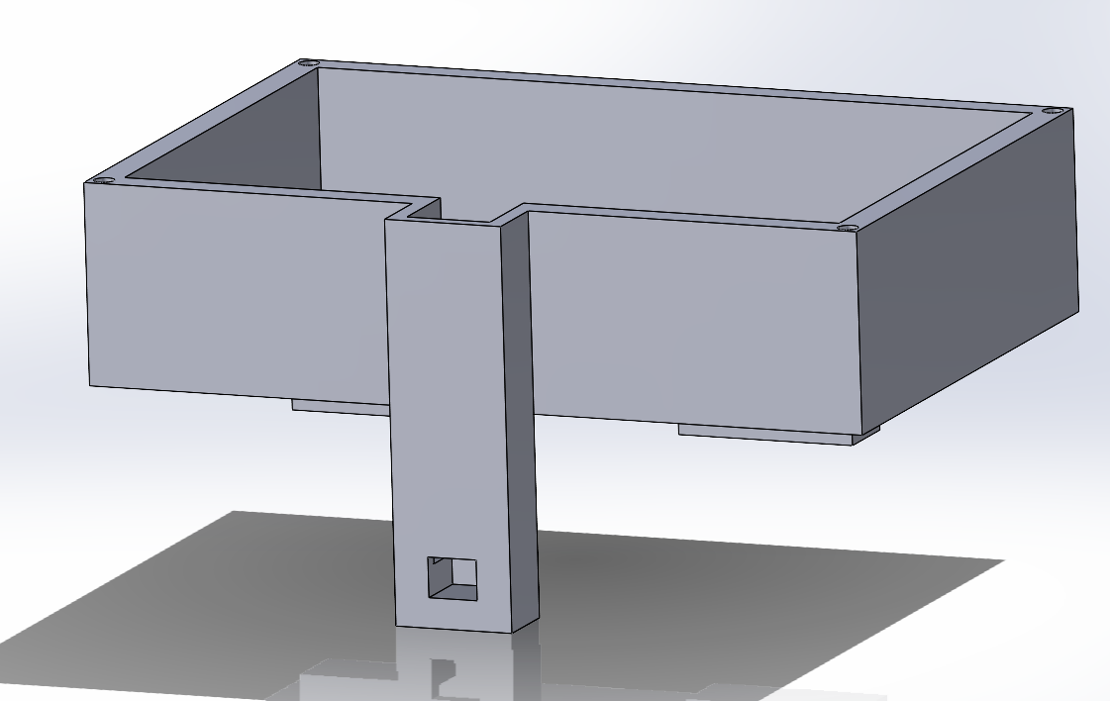
Work Subsystem
Creation of a Work Map
Rotation of Wheel
Circumference
Elevation
Using this Work Map
Drives Resistance
Drives Audio / Video
Notes:
This is how a workmap is created
Mention that a rotation of the wheel is what tells the other sensors to take a measurement
The circumference of the wheel is what gives us distance to be used

Slide 13
Work Subsystem Analysis
The Work Map
Within 0.00126 Miles during a 0.2 Mile test (one tire rotation).
Elevation within 3 Feet.
Work Measured 47 kJ vs 42.5 kJ average actual
31 MPH (Definitely not 190 MPH)
Notes:
Mention that during our test our worst distance off was 0.00126 which was just a singular tire rotation
Our worst distance off for elevation was 3 feet

Slide 14
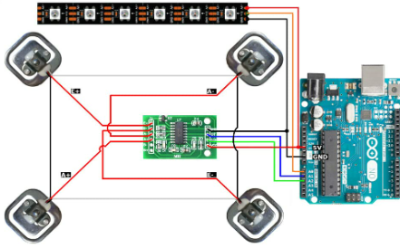
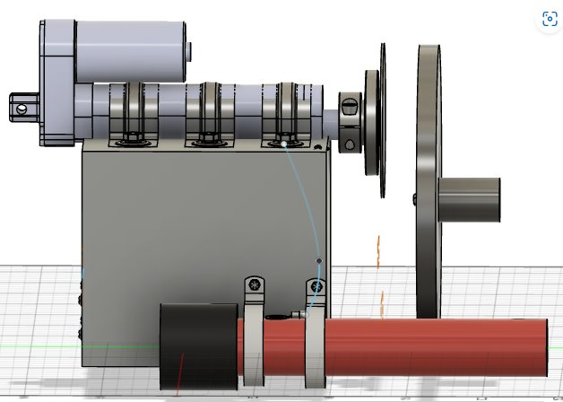
Resistance Subsystem
Force Sensor
Force exerted by the user
Calculate Work
Move Work Map
Linear Actuator
From Work Map
Calculate Actuator Distance
Move Actuator to change resistance

Slide 15
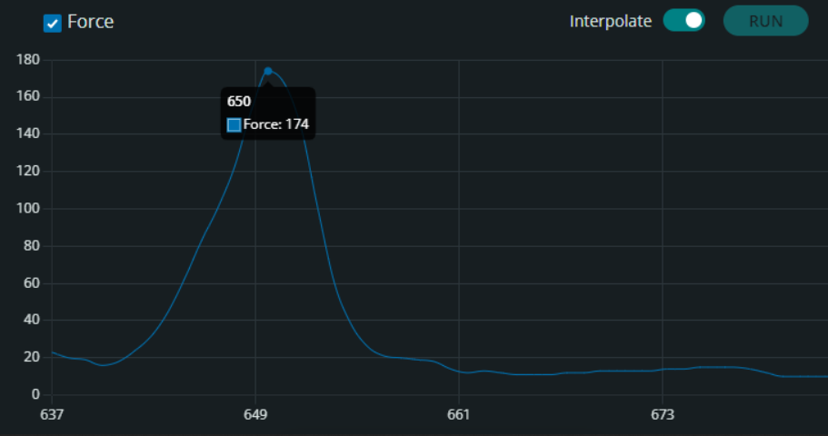
Resistance Subsystem Analysis
Actuator Distance
Scalable to Work value
Min and Max distance
Maximum Force
Within sensor limits
Housing Security
Does not fall off
Does not inhibit ride

Slide 16


GUI Subsystem
Objective
To provide a fast and simple GUI for the Ride Replay Kit
The Journey
Switching from Tkinter to PyQt
Notes:
Objectives
Lower than 300ms latency for any interaction
Simple GUI not bogged down with too many unnecessary options
Color Blind sensitive
Alert the user after 2 hours of continued use
The Journey
Half way through the creation of the GUI I had to completely switch to a new GUI library because the original was causing the system to freeze. To solve this I switched to a different GUI library called pyqt and it allowed me to implement multi threading on the raspberry pi which fixed the issue with freezing.
After the switch I was able to implement the systems together to allow for the user to enjoy the trail and fans to scale up and down according to their speed and still be able to interact with the GUI

Slide 17
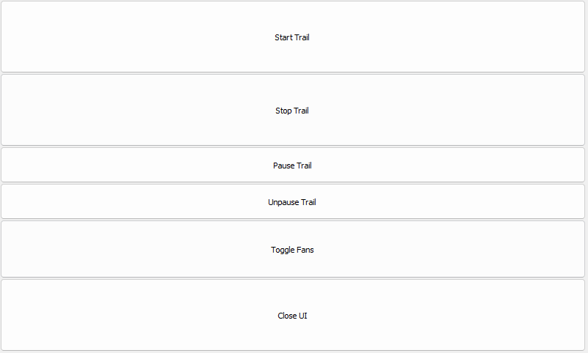
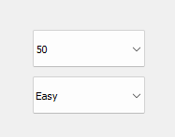
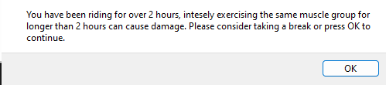
GUI Subsystem
Notes:
The GUI
The starting of the GUI begins with prompting the user to input their weight and the difficulty they would like to ride at through the touch screen menu. This data is used later on for the work map calculation.
The main menu allows the user to start, stop, pause, and un-pause the trail.
The toggle fans button allows the User to turn on and off the immersion system in case the user finds the fans more of a nuisance.
Lastly, the close UI button forces the program to shut down.
A pop up reminder shows whenever the user has been riding for longer than 2 hours to ensure the user does not cause damage to their muscles.

Slide 18
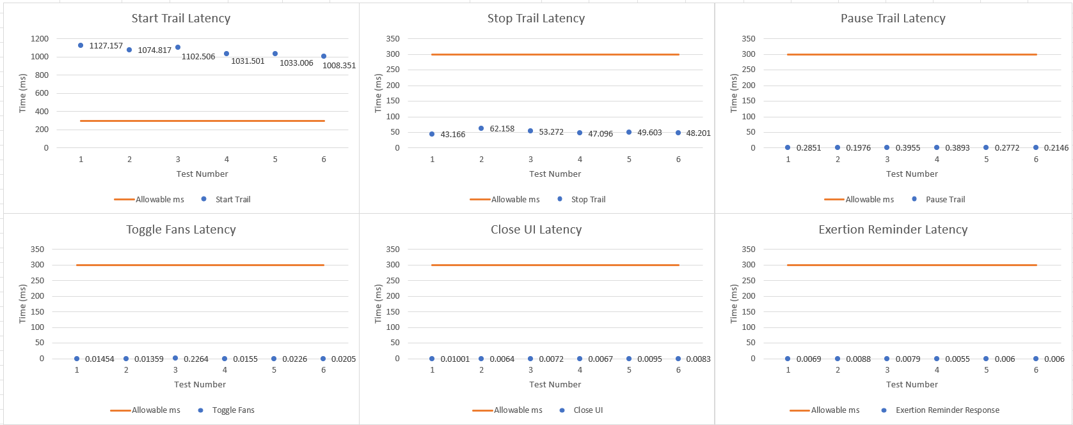
GUI Subsystem
Notes:
Results of Testing
Only one function of the GUI failed to meet the constraint of being under 300ms. To avoid user frustration I added a loading screen that shows the user that their input has been acknowledged and is currently being handled. This was to avoid the user getting frustrated and overloading the system with multiple inputs.

Slide 19
Projected Vs Actual Costs
Subsystem | Projected Cost | Actual Cost
Audio | $80 | $195.78
Video | $425 | $0*
Resistance | $135 | $86.58
Work | $25 | $93.32
Immersion | N/A | $103.56
GUI | $0 | $0
Total | $665 | $479.24

Slide 20
Future Work
Improve upon the process that the audio segments are split up
Improve visual resolution
Redesign of the 3D prints to fit more bikes
Upgrade the current Raspberry Pis running the systems
Condense the documentation from prior renditions of the project

Slide 21
Acknowledgements
Jesse Roberts
Conard Murray
Jeff Randolph
Jeffrey Austen
Sterling Sloan

